Slide 1
3-Level NPC Inverters
Thesis: DC-LINK CAPACITOR SIZING OF THREE-LEVEL NEUTRAL POINT
CLAMPED VOLTAGE SOURCE INVERTERS FOR VARIABLE SPEED DRIVES

Slide 2
Advantages & Disadvantages
Advantages against 2-Level Inverter:
- Efficiency
- 1/2Vdc voltage stress
Disadvantages against 2-Level Inverter :
- Complexity
- Unequal Power Loss

Slide 3
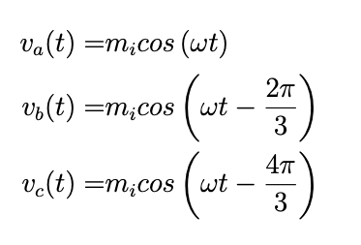
Sinusoidal PWM
Phase voltages (reference signals);
Two triangular carrier signal [0,Vdc/2] & [-Vdc\2,0]

Slide 4
SVPWM

